Slide 1

Lesson Nine Energy And You
The Harnessed Atom

Slide 2
What you need to know about Energy Decision-making:
Standard of living
Economics
Supply and demand
Informed decisions
Risks and benefits
Utility costs
Tradeoffs
What energy means to you
Careers

Slide 3


What is economics?
Economics is the study of how we make choices about using our resources to satisfy our needs…and wants.
Notes:
Ask Students: What is the difference between need and want. How do the photographs illustrate a difference? (Answer: Water is a basic need for all humans. Soda is often a want, something we may desire but don’t need to live. )
Some people define economics as the study of unlimited wants satisfied by limited resources.
Tell Students: People who study economics are economists. Economists sometimes make decisions about energy

Slide 4

What does economics have to do with energy?
To have enough energy to meet our needs, we must make choices about which resources we will use. There are limited energy resources to meet our growing demands and there are both costs and benefits for each source.

Slide 5

Compare the costs and benefits of energy choices.
The costs of choosing an energy source can include the money spent building a power plant, buying fuel, and operating the plant.
Costs also include consequences, like
Using up natural resources
Damaging the environment
Damaging health
Depending on another country.
Notes:
Gainesville, GA photo from EPA web site. Citizens make brush bundles to stem affects of erosion, 2008.
Ask students if they know of any local efforts to protect the environment. Are any related to energy use?

Slide 6

What are the benefits?
Benefits are the good things that come from affordable electricity production. Name some you can think of.
Benefits include our whole economy. Name an industry that doesn’t use electricity.
Notes:
The benefits include lights, heat, and air conditioning in our home, the ability to run our computers, phones, and games, and to refrigerate and cook our meals. But the benefits go much further. Your classroom, medicines and manufacturing, and stores at the mall all are possible because of the benefits of affordable electricity. Our whole economy depends on it. The goal is to choose a mix of energy sources that gives the most benefits to society.

Slide 7

What are supply and demand?
Supply is the amount of a product available.
Demand is how much of a product people want and can buy.
Notes:
Ask students to imagine you and your friends buy a bag of gummy bears. The bears you have are the supply. What if everyone likes the red ones best? Red bears are in demand. When you divide the bears, which ones will be picked first? The ones in the greatest demand will go first. Your supply might not meet the demand.

Slide 8

How do supply and demand affect you?
If the demand is greater than the supply, something will change:
Sellers will charge more for their product.
Buyers may be willing to pay a higher price.
Buyers may choose to go without.
Buyers may choose to buy something else.
Notes:
Ask students to apply this economy fact to the gummy bear scenario. If red bears were sold separately, would they cost more or less than other colors? (More) What would happen if buyers weren’t willing to pay more? (They may not eat any bears or they might choose other colors.)
Take the results a step further: Ask students what might happen if no one bought the bears at the higher price, what might the seller decide to do? (lower the price).

Slide 9
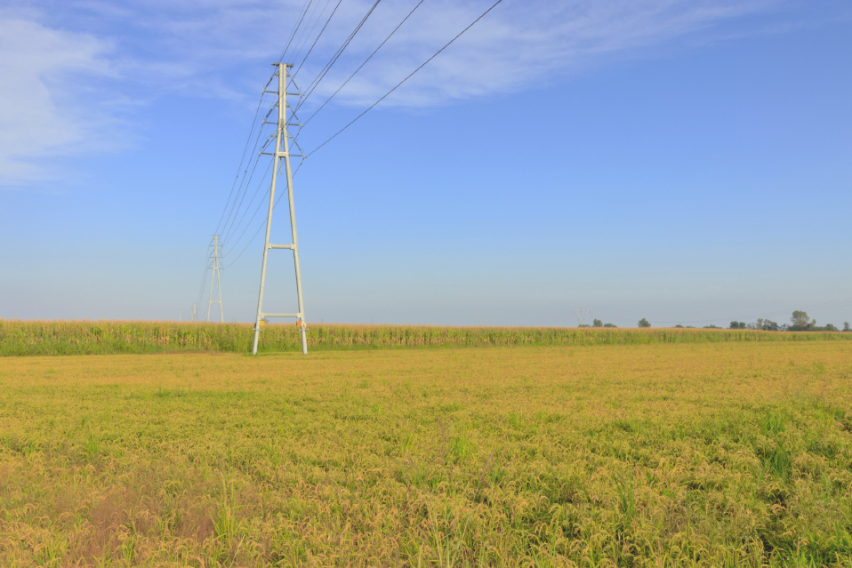
How do supply and demand affect electricity?
Utility companies build power plants to provide the supply of electricity. If people demand more electricity, what happens? The price goes up. People may have to use less. Our standard of living might change.
Making sure that there is an ample and reliable supply of electricity is the only way to keep electricity affordable.
Notes:
Energy demand exceeded our supply in the 1970s. Countries belonging to the Organization of Petroleum Exporting Countries stopped selling oil to us to protest the U.S. involvement in the 1973 Arab-Israeli War. We bought oil from other countries, but our supply was suddenly limited and the price of oil went up. There was not enough gasoline to meet the demands of Americans. People had to wait in line to buy gasoline, they could buy only limited amounts, and the price of gasoline went up. Businesses and industries could no longer afford to buy as much oil. Their production dropped, and workers were laid off.

Slide 10
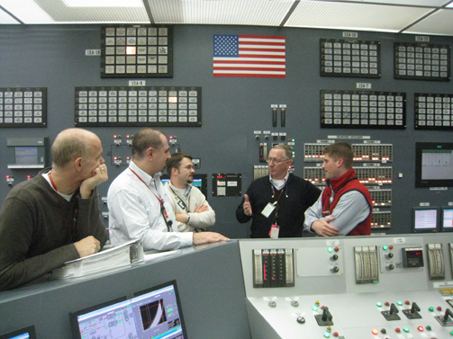
What do utility companies consider when deciding what kind of power plant to build?
People who operate utility companies must carefully consider the costs, risks, and benefits of building any new power plant.
The costs for electricity from a power plant include
construction costs
fuel costs
operating costs.
Notes:
Construction cost. This includes the cost of the land, the steel and concrete and electronics, and the salaries for the workers who build it. It also includes the interest on money borrowed to build the plant. Nuclear plants have the highest safety standards of all and take longer than other types of power plants to build. Therefore, their construction costs are higher.
Fuel costs of a power plant depend on the availability of the fuel and the amount of energy it contains. The energy in uranium is very high, so although it is expensive, utility owners do not have to buy much of it. One load of fuel lasts 3 years. Fuel cost is about 30 percent of the cost of electricity from nuclear plants. It is about 80 percent of the cost from coal or natural gas plants. Other factors, like reliability, can also increase the fuel costs of power plants.
Operating costs go toward keeping to power plant running. They include paying the plant workers and maintaining and upgrading the power plant.
Photo from NRC: Commissioner Ostendorff and inspectors discuss upcoming refueling outage and installation of a digital control system at Oconee nuclear power plant in Oconee, SC nuclear power plant

Slide 11
What will more people do to our energy demand?
For most of Earth’s history, the total population of humans was less than 10 million. In the last 2 centuries, it has climbed to 7 billion. It may reach 10 billion by 2050.
Notes:
Some economists predict we will need about 23 percent more electricity by 2035. To supply this demand, they predict that utilities in the United States will build hundreds of new electrical power plants.
Ask students to consider
How old will they be in 2050?
What will happen to supplies when demand increases?
What will happen to the price of fuels as demand grows?
What might the environmental impact be of using the same energy mix we now use?

Slide 12

Why does the kind of power plant matter to you?
You will be making choices about how we should supply our future energy demands. You will have to decide what tradeoffs we should accept.
We will always use energy. But the mix of resources will change.
You may one day be a smart scientist, engineer, or inventor working to create new energy options and conserve what we have.
Notes:
As you know, middle school is not too young for many students to start thinking about what they want to do in the future. Math, science, and technology classes are important for them to explore.

Slide 13
Summary: Fill in the blanks
There are risks and benefits that come with all energy sources.
Supply is the amount of a product available. Demand is how much of a product people want and can buy.
An important question in the United States today is what sources we will use to supply our energy in the future.
A big part of that question is what sources of energy we will use to make the electricity our standard of living depends on.
Notes:
The answers are in the sentences above. You can turn this page into an activity using your cursor to highlight the blank spaces. Use your toolbar to make the answers’ font not white.
Review these facts with students before or after a quiz.

Slide 14
Summary (continued)
Utilities consider costs and benefits when deciding what type of power plant to build. All energy sources have both benefits and risks.
Making informed decisions about energy requires
• defining the problems accurately,
• gathering information about pros and cons, and
• evaluating the information by comparing and weighing the risks and benefits.
Notes:
The answers are in the sentences above. You can turn this page into an activity using your cursor to highlight the blank spaces. Use your toolbar to make the answers’ font not white.
Review these facts with students before or after a quiz.

Slide 15
Lesson 9 Vocabulary
benefits – good things that come from a choice; something that affects individuals and society
consequences – the effects, results, or outcomes of something occurring earlier
construction costs – money required to buy land and materials, pay workers’ salaries, and pay interest to borrow money to build
costs – the amount of money we must pay now and in the future; consequences like environmental damage, dependence on another country, and health risks
demand – the amount of product people want and can buy
economics – the study of how we decide to use our resources to meet our needs and wants

Slide 16
Vocabulary
fuel costs – money required to buy fuel
informed decisions – the outcome of considering the risks and benefits of choices
operating costs – money required to keep a system running
risk – a situation involving exposure to danger or from which there may be an unwanted outcome
risk-benefit analysis - the comparison of the risk of a situation to its related benefits
standard of living – a measurement of how well the needs and wants of a country’s people are met
supply – the amount of a product available
tradeoff – the giving up of one desirable thing in exchange for something more desirable

